Slide 1


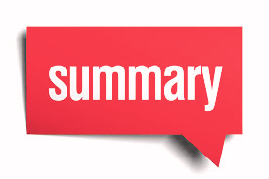

Youtube Transcript Summarizer
Presented by:
20BCP151 - Sahaj Bhadja
20BCP171 - Vishwa Gajjar
Presented to:
Dr. Rajeev Gupta

Slide 2


Table of Contents
Introduction
Literature Survey
Methodology
Upcoming improvements
Conclusion
References

Slide 3
Introduction
Enormous number of video recordings are being created and shared on the Internet through out the day. It becomes really difficult to spend time in watching such videos which may have a longer duration than expected and sometimes our efforts may become futile if we couldn't find relevant information out of it.
Summarizing transcripts of such videos automatically allows us to quickly look out for the important patterns in the video and helps us to save time and efforts to go through the whole content of the video.
Summarize to Prioritize: Your Time-Saving Tool

Slide 4
Use cases
Education: In educational settings, teachers and students can benefit from transcript summarization. Teachers can provide summarized transcripts to help students review lessons, and students can use these summaries as study aids.
Research and Analysis: Researchers and analysts can use transcript summarization to quickly review large volumes of video content for insights, trends, or relevant information.
News and Journalism: Journalists and news outlets may use transcript summarization to provide concise summaries of video interviews, press conferences, or speeches.
Language Translation: Transcript summarization can be used as an intermediate step for machine translation, making it easier to translate and understand video content in different languages.
Social Media Sharing: Users can share summarized versions of videos on social media, enabling them to convey the main message or takeaway without requiring followers to watch the entire video.

Slide 5
Literature Survey
Paper Title | Authors | Year | Key Contributions
Abstractive Summarization of video sequences | AniqaDilawari, Muhammad Usman Ghani Khan | 2019 | Used multi-line video description, RCNN deep neural network model. The drawback is - It focuses only on the conciseness of the summary and not on Memory efficiency and time constraints.
Study on Abstractive Text Summarization Techniques | Parth Dedhia, Hardik Pradeep, Meghana Naik | 2021 | Used Encoder-Decoder, and Pointer Mechanism. Drawback is that the current model does not work if multiple documents are passed to the model.
Video Summarization Using Deep Neural Networks | Apostolidis, Evlampios, et al | 2021 | Discussed the main characteristics of a typical deep-learning-based analysis pipeline. Then, suggested a taxonomy of the existing algorithms and provide a systematic review of the relevant literature

Slide 6
Literature Survey Contd.
Paper Title | Authors | Year | Key Contributions
Video Transcript Summarizer | A. N. S. S. Vybhavi, L. V. Saroja, J. Duvvuru and J. Bayana | 2022 | Authors propose a video summarizing system based on natural language processing (NLP) and Machine Learning to summarize the YouTube video transcripts without losing the key elements
Natural Language Processing (NLP) based Text Summarization - A Survey | Ishitva Awasthi, Kuntal Gupta, Prajbot Singh Bhojal, Anand, Piyush kumar | 2021 | The techniques used are Extractive and abstract methods for summarizing texts. The advantages are: Based on linguistic and statistical characteristics, the implications of sentences are calculated. The disadvantage is each type of summarization technique is useful in different situations

Slide 7
Methodology
1) Extracting Transcript Text from Video
YoutubeTranscriptApi - Get_transcript(video_id): Python library that allows you to get the transcripts or subtitles for a YouTube video.
Returns Json objects: For every segment that has some audio and caption, it extracts text.
Extract text from Json objects

Slide 8
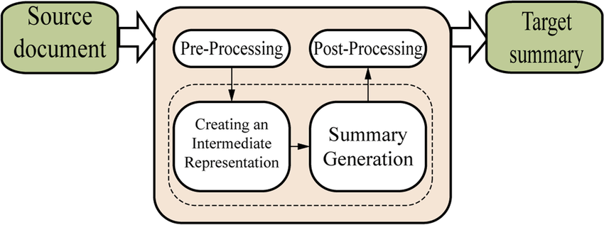
Methodology
2) Summarizing the Transcript Text
Model:
BERT Model
(Bidirectional Encoder Representations from Transformers)
Process:
Initiate a summarization pipeline.
Create chunks, iterate and summarize.

Slide 9
Conclusion
In conclusion, our YouTube Transcript Summarizer project has successfully integrated video text extraction through API.
We are leveraging the BERT model for text summarization.
Moving forward, we will explore alternative models like GPT2, XLNET and implement length limits for summaries to enhance user experience and adaptability.
Our commitment to improvement ensures that we continue to provide valuable video content summarization services.

Slide 10
References
A. Dilawari and M. U. G. Khan, "ASoVS: Abstractive Summarization of Video Sequences," in IEEE Access, vol. 7, pp. 29253-29263, 2019, doi: 10.1109/ACCESS.2019.2902507.
P. R. Dedhia, H. P. Pachgade, A. P. Malani, N. Raul and M. Naik, "Study on Abstractive Text Summarization Techniques," 2020 International Conference on Emerging Trends in Information Technology and Engineering (icETITE), 2020, pp. 1-8, doi: 10.1109/ic-ETITE47903.2020.087.
E. Apostolidis, E. Adamantidou, A. I. Metsai, V. Mezaris and I. Patras, "Video Summarization Using Deep Neural Networks: A Survey," in Proceedings of the IEEE, vol. 109, no. 11, pp. 1838-1863, Nov. 2021, doi:10.1109/JPROC.2021.3117472.
A. N. S. S. Vybhavi, L. V. Saroja, J. Duvvuru and J. Bayana, "Video Transcript Summarizer," 2022 International Mobile and Embedded Technology Conference (MECON), 2022, pp. 461-465, doi: 10.1109/MECON53876.2022.9751991.
I. Awasthi, K. Gupta, P. S. Bhogal, S. S. Anand and P. K. Soni, "Natural Language Processing (NLP) based Text Summarization - A Survey," 2021 6th International Conference on Inventive Computation Technologies (ICICT), 2021, pp. 1310-1317, doi: 10.1109/ICICT50816.2021.9358703.
https://pypi.org/project/youtube-transcript-api/
https://huggingface.co/transformers/installation.html

Slide 11
THANK YOU

